Slide 1
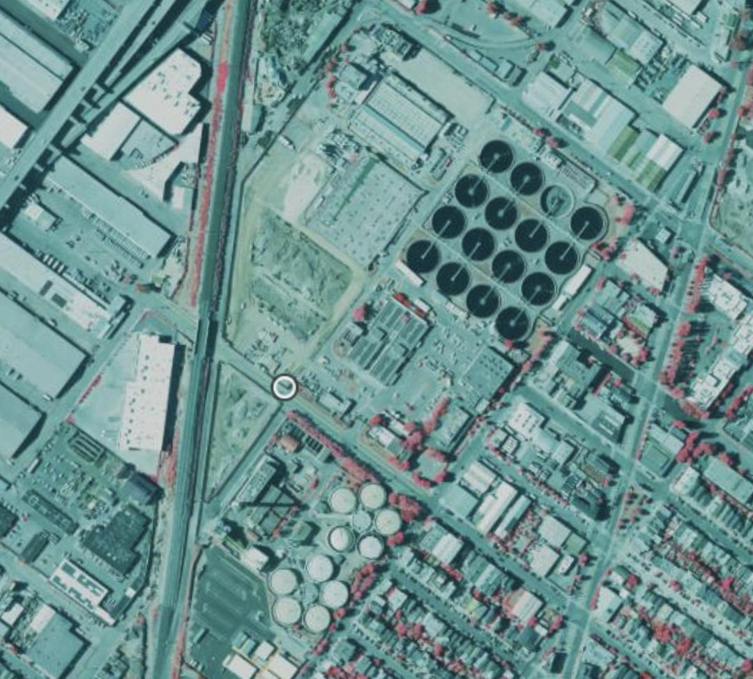
WWTP Project Update
September 28, 2023

Slide 2
Outline
Current Status
Data Collection and Tools
Key Concerns and Questions
Next Steps
Notes:
We also want to go over some images we put in the Appendix if time permits

Slide 3
Current Status
Validated the provided dataset for WWTP and solar panel.
Failed to identify solar panels for 3 WWTPs out of 41
Appendix
Developed a data collection pipeline
Downloaded satellite images for 3,000+ potential WWTPs in California
Cleaning Needed
Notes:
enabling the identification of WWTP locations and automatic downloading of corresponding satellite images.

Slide 4
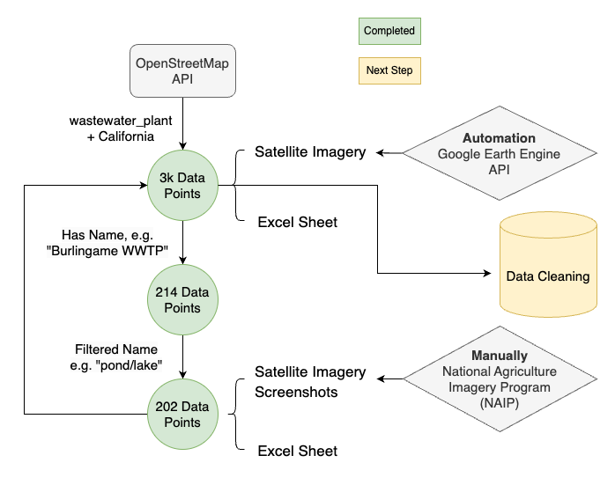
Data Collection Process
OpenStreetMAP API Notebook
Automation Notebook
3k WWTP Excel Sheet
Satellite Imagery

Slide 5
Utilized Tools
OpenStreetMap
National Agriculture Imagery Program (NAIP)
Google Earth Engine

Slide 6
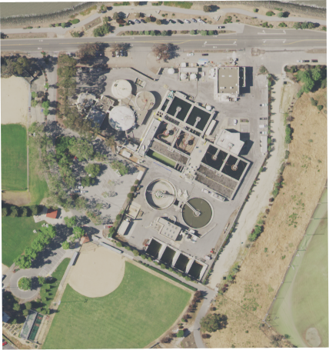
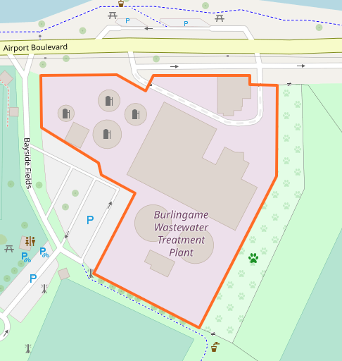
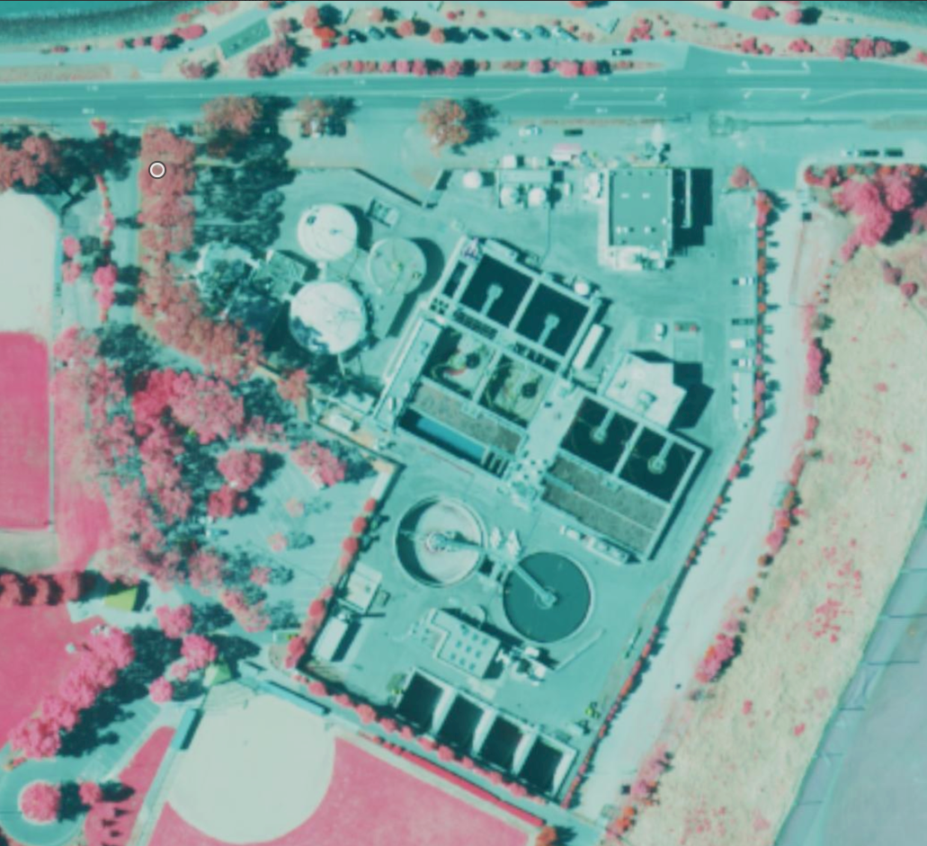
Illustrative Example
Burlingame Wastewater Treatment Plant.jpg
Cross check with OpenstreetMap:
Cross check with NAIP manual crop:

Slide 7
Key Concerns and Questions
Can you please go over how you verify the 41 WWTP list?
What criteria identify an instrument as a WWTP?
Are waterpools associated with WWTPs?
What is the size of the WWTPs?
Should WWTPs within oil refineries be included?
Do we consider inactive WWTPs initially, with the option to filter later?

Slide 8
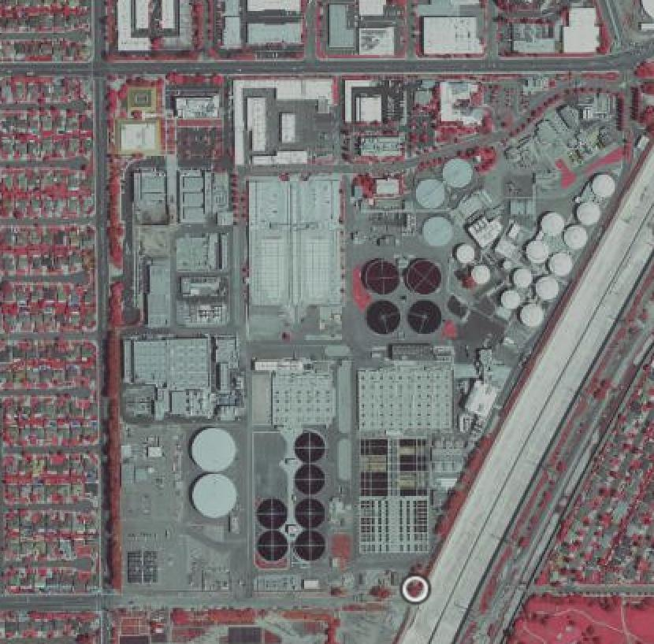
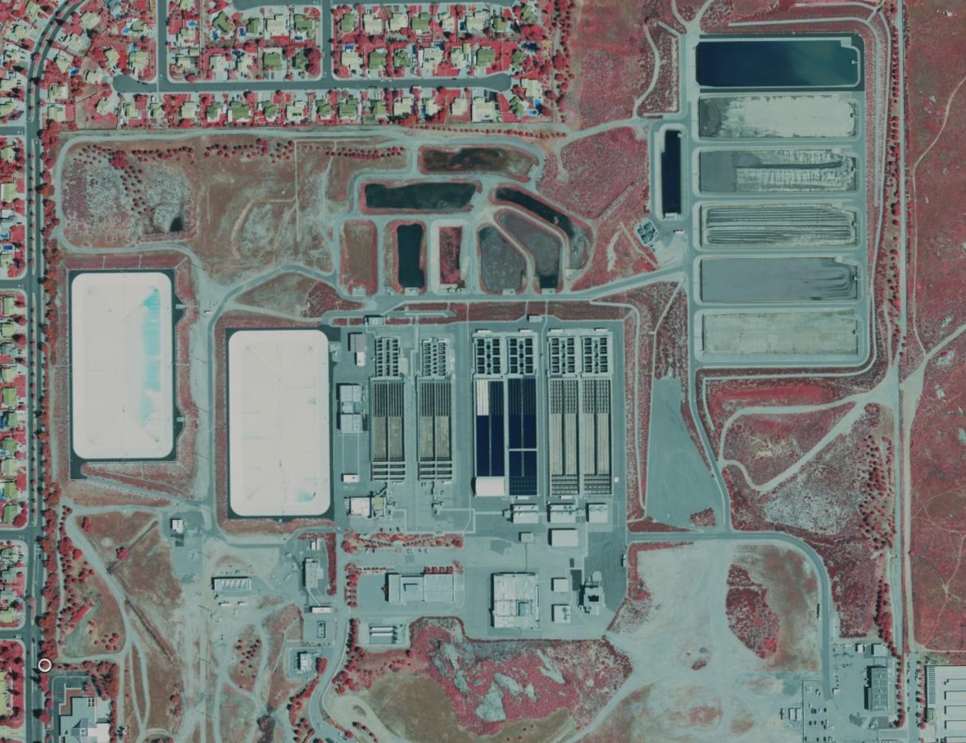
Key Concerns and Questions
What criteria identify an instrument as a WWTP?
With cylindrical structures
Without cylindrical structures
-117.9403686, 33.6871191
-117.3245418, 33.9183035

Slide 9
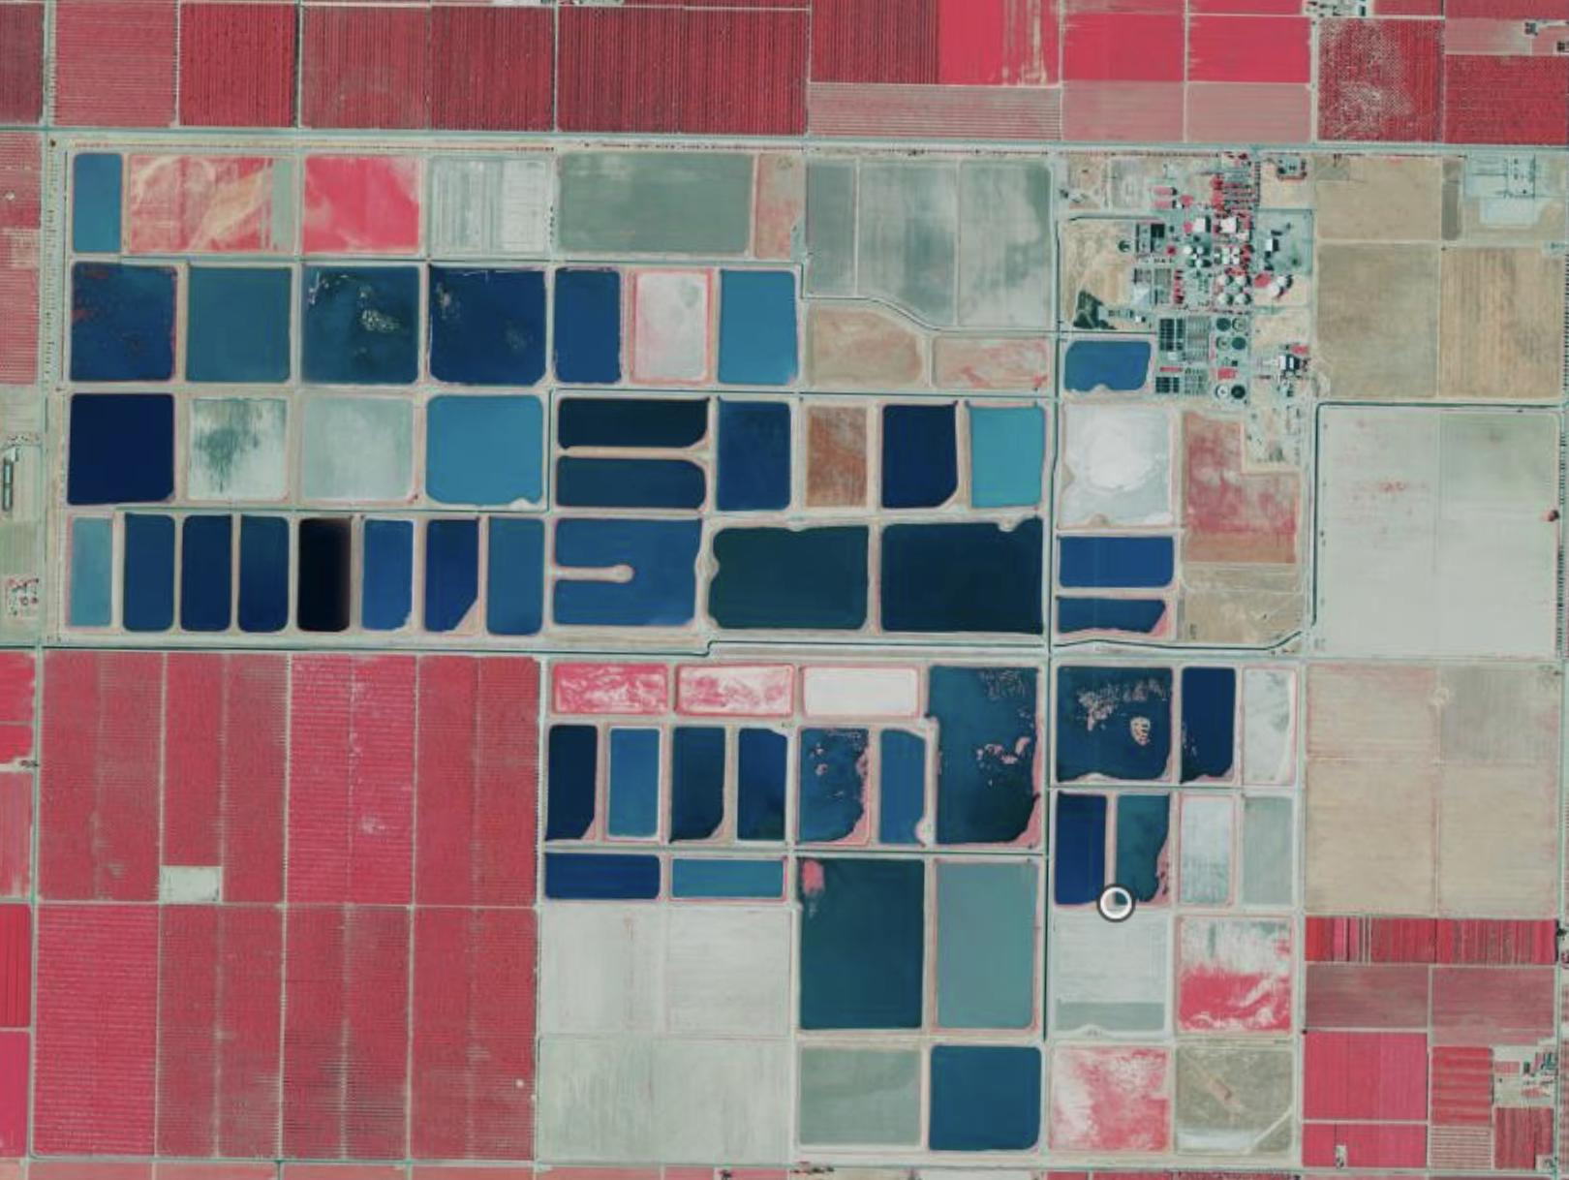
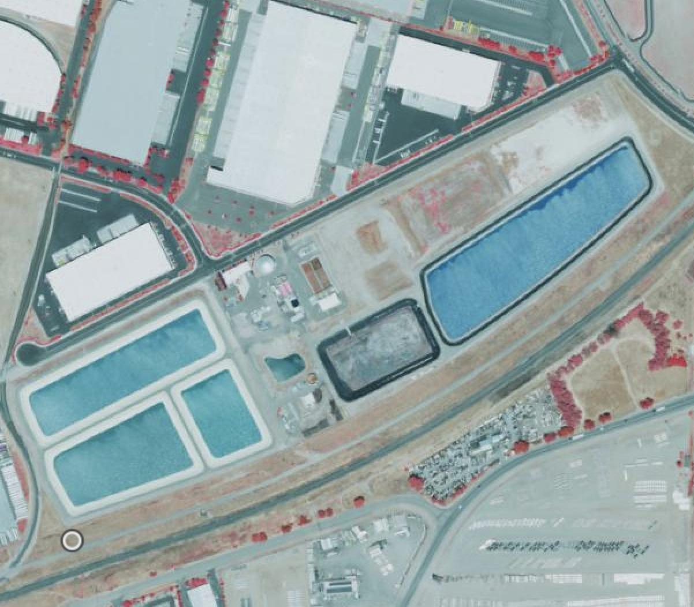
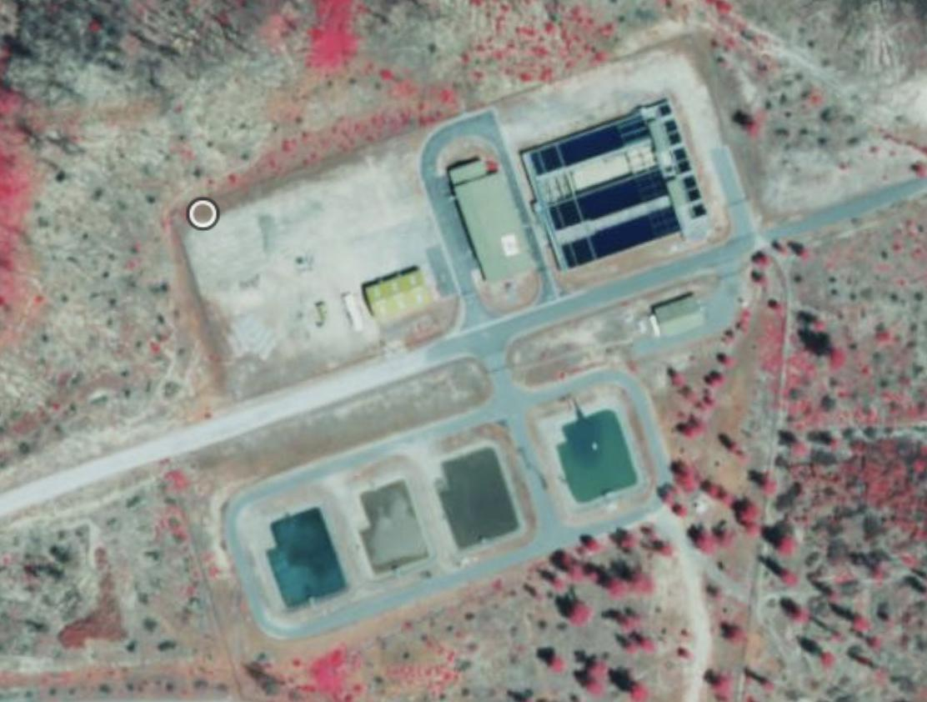
Key Concerns and Questions
How do we determine the true size of the WWTPs? Are waterpools associated with WWTPs?
-119.896203, 36.6848721
-121.2905832, 37.7926388
-122.489469, 40.6269335
Notes:
Waterpool instead of round circle?

Slide 10
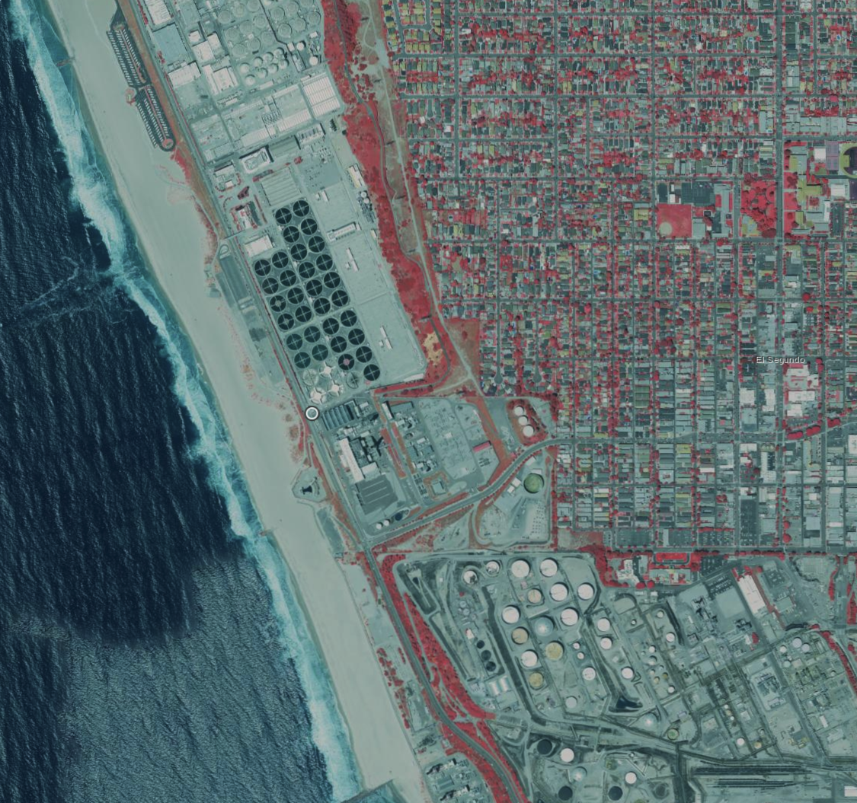
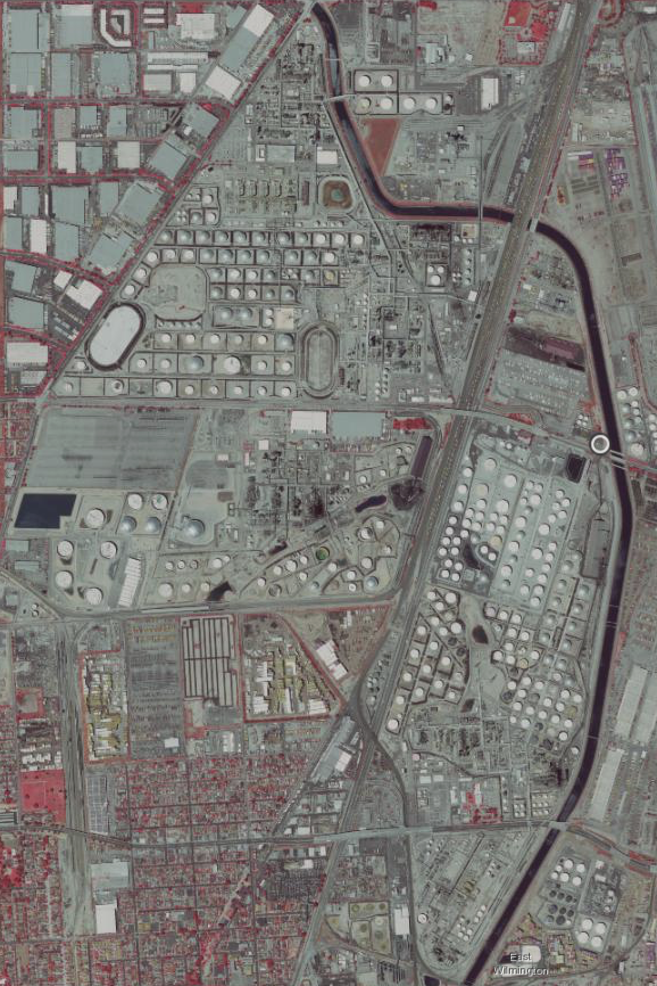
Key Concerns and Questions
Should WWTPs within oil refineries be included?
Department Of Water And Power City Of Los Angeles Scattergood Steam Plant
Tesoro Los Angeles Refinery
Chevron Products Company El Segundo Refinery
-118.4291394, 33.9195675
-118.2287241, 33.8067125
Notes:
Need to understand where the center is, how expansive can the area be

Slide 11
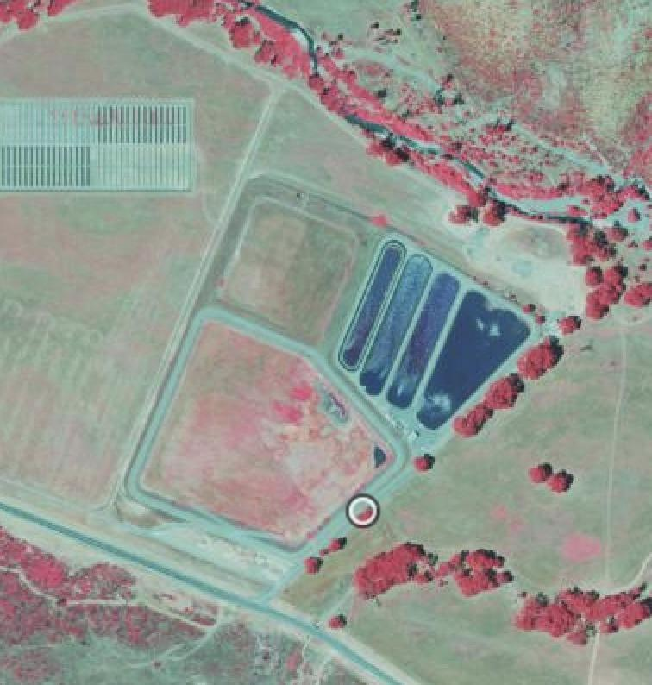
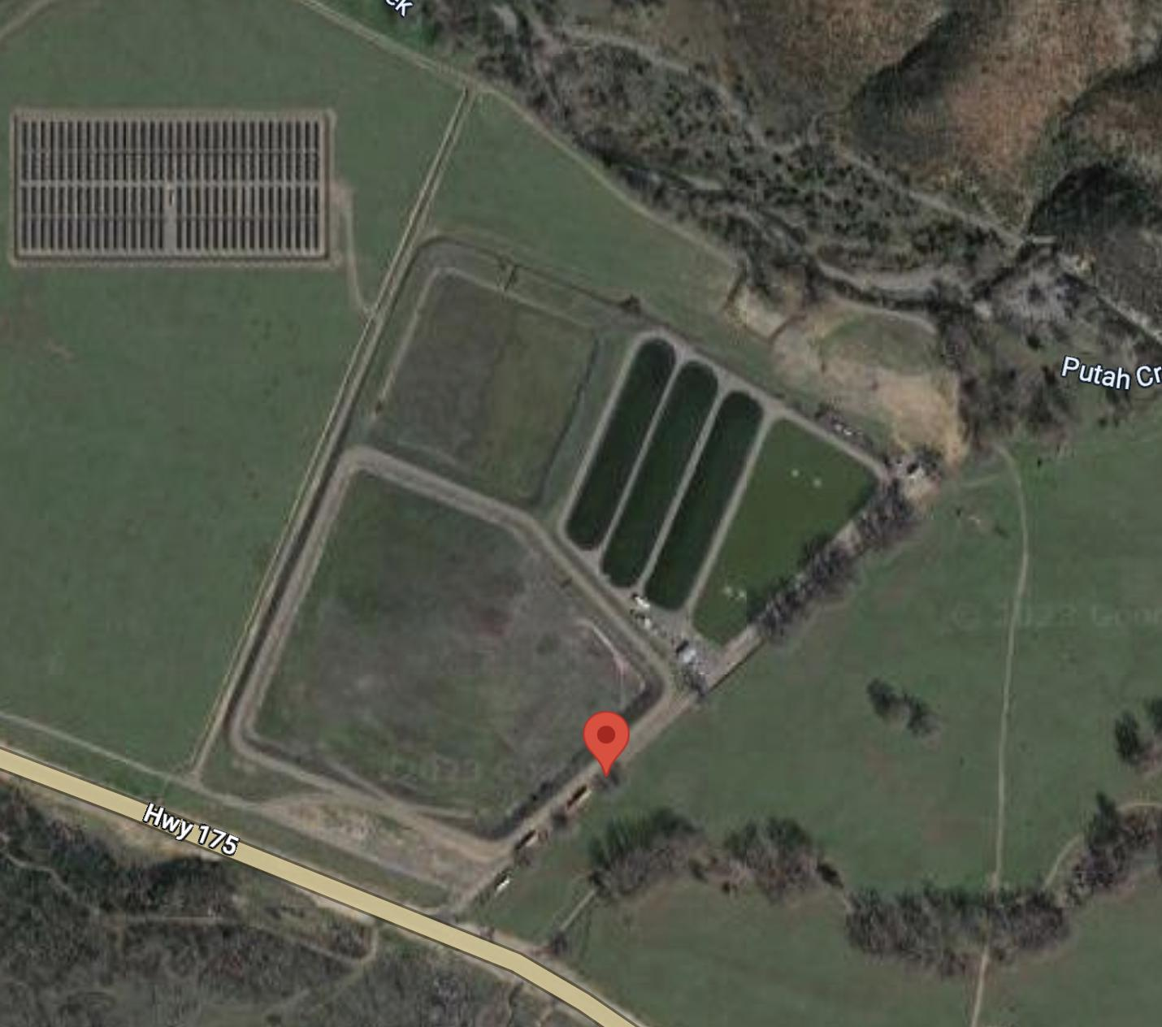
Key Concerns and Questions
Do we consider inactive WWTPs initially, with the option to filter later?
-122.6471156, 38.766253

Slide 12
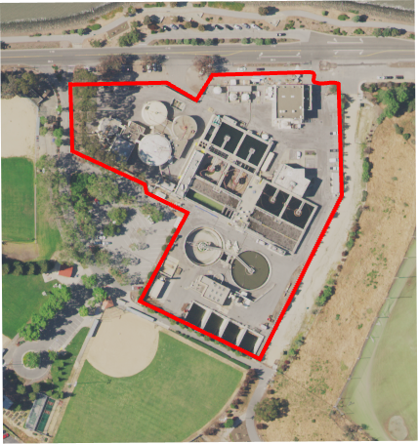
Next Steps
Data Cleaning, Validation & Analysis
Verify the downloaded image has the complete WWTP
Identify redundant cropped images
Data Augmentation
Add WWTP schematics to the cleaned dataset

Slide 13
Appendix

Slide 14
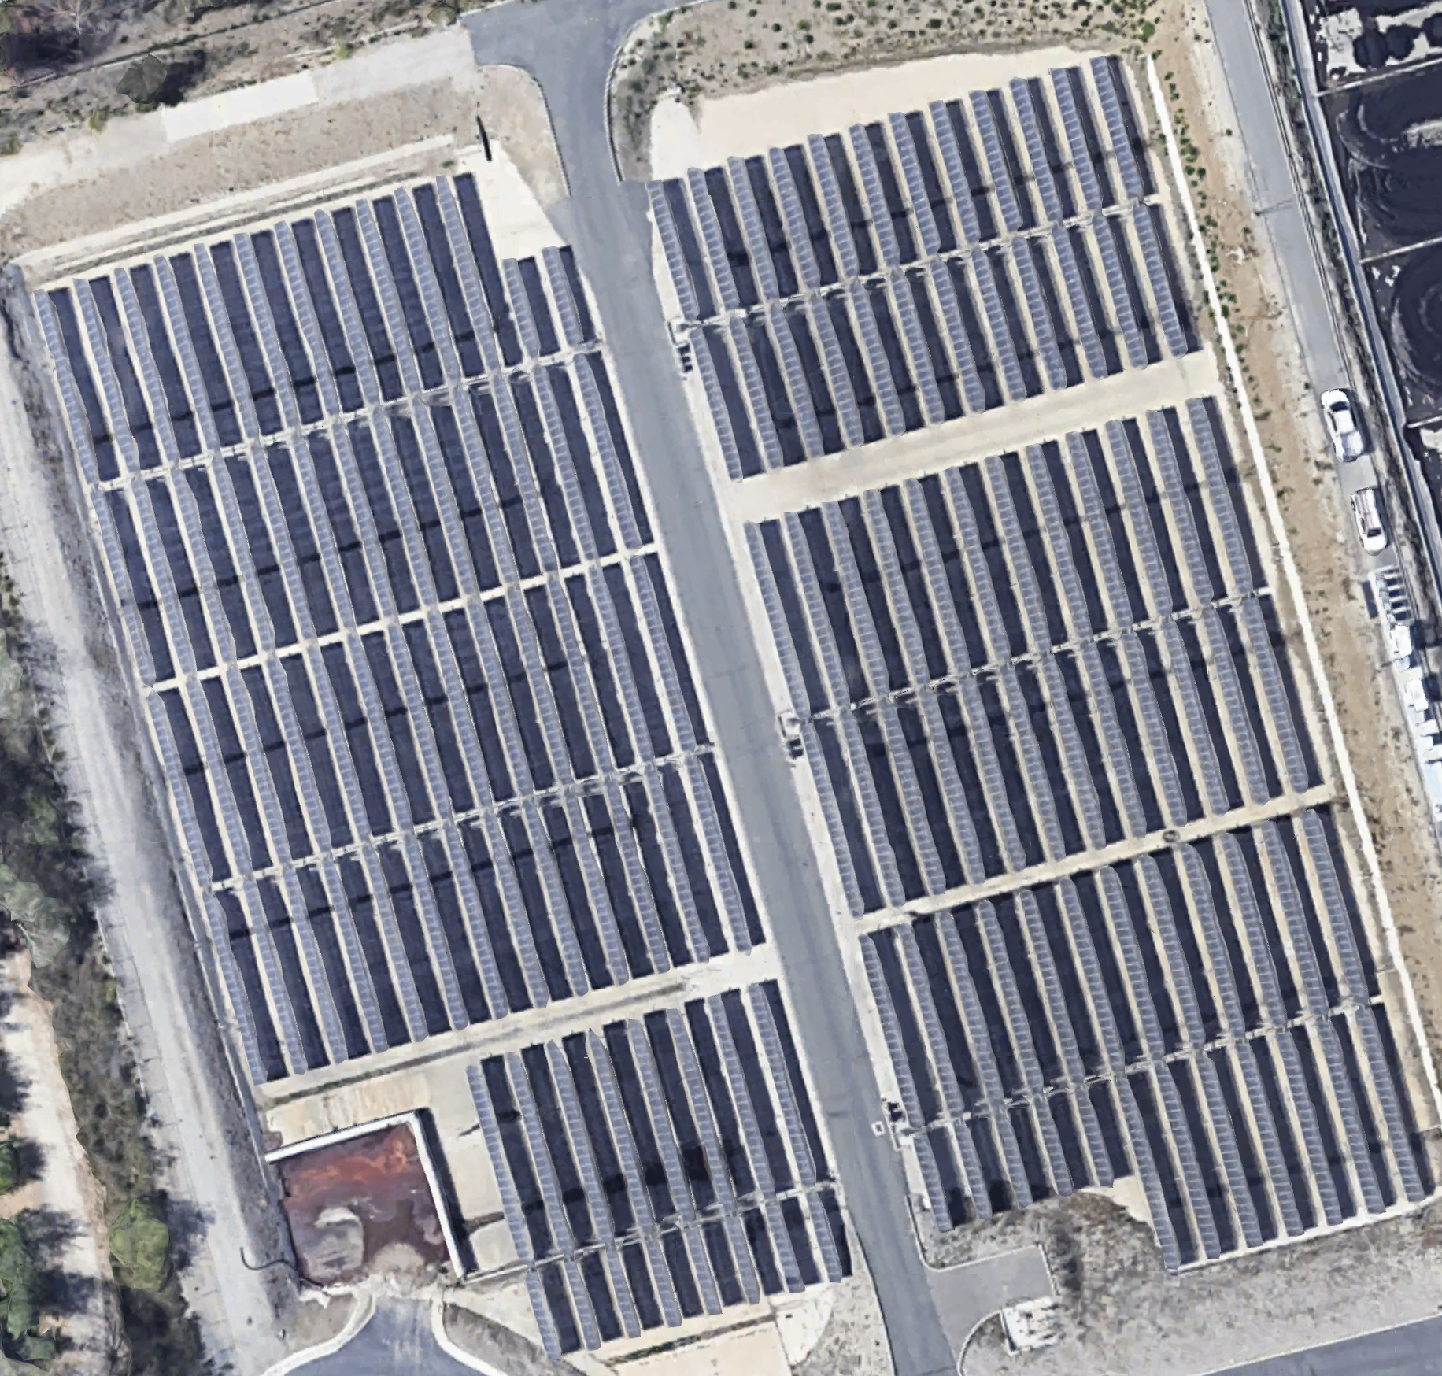
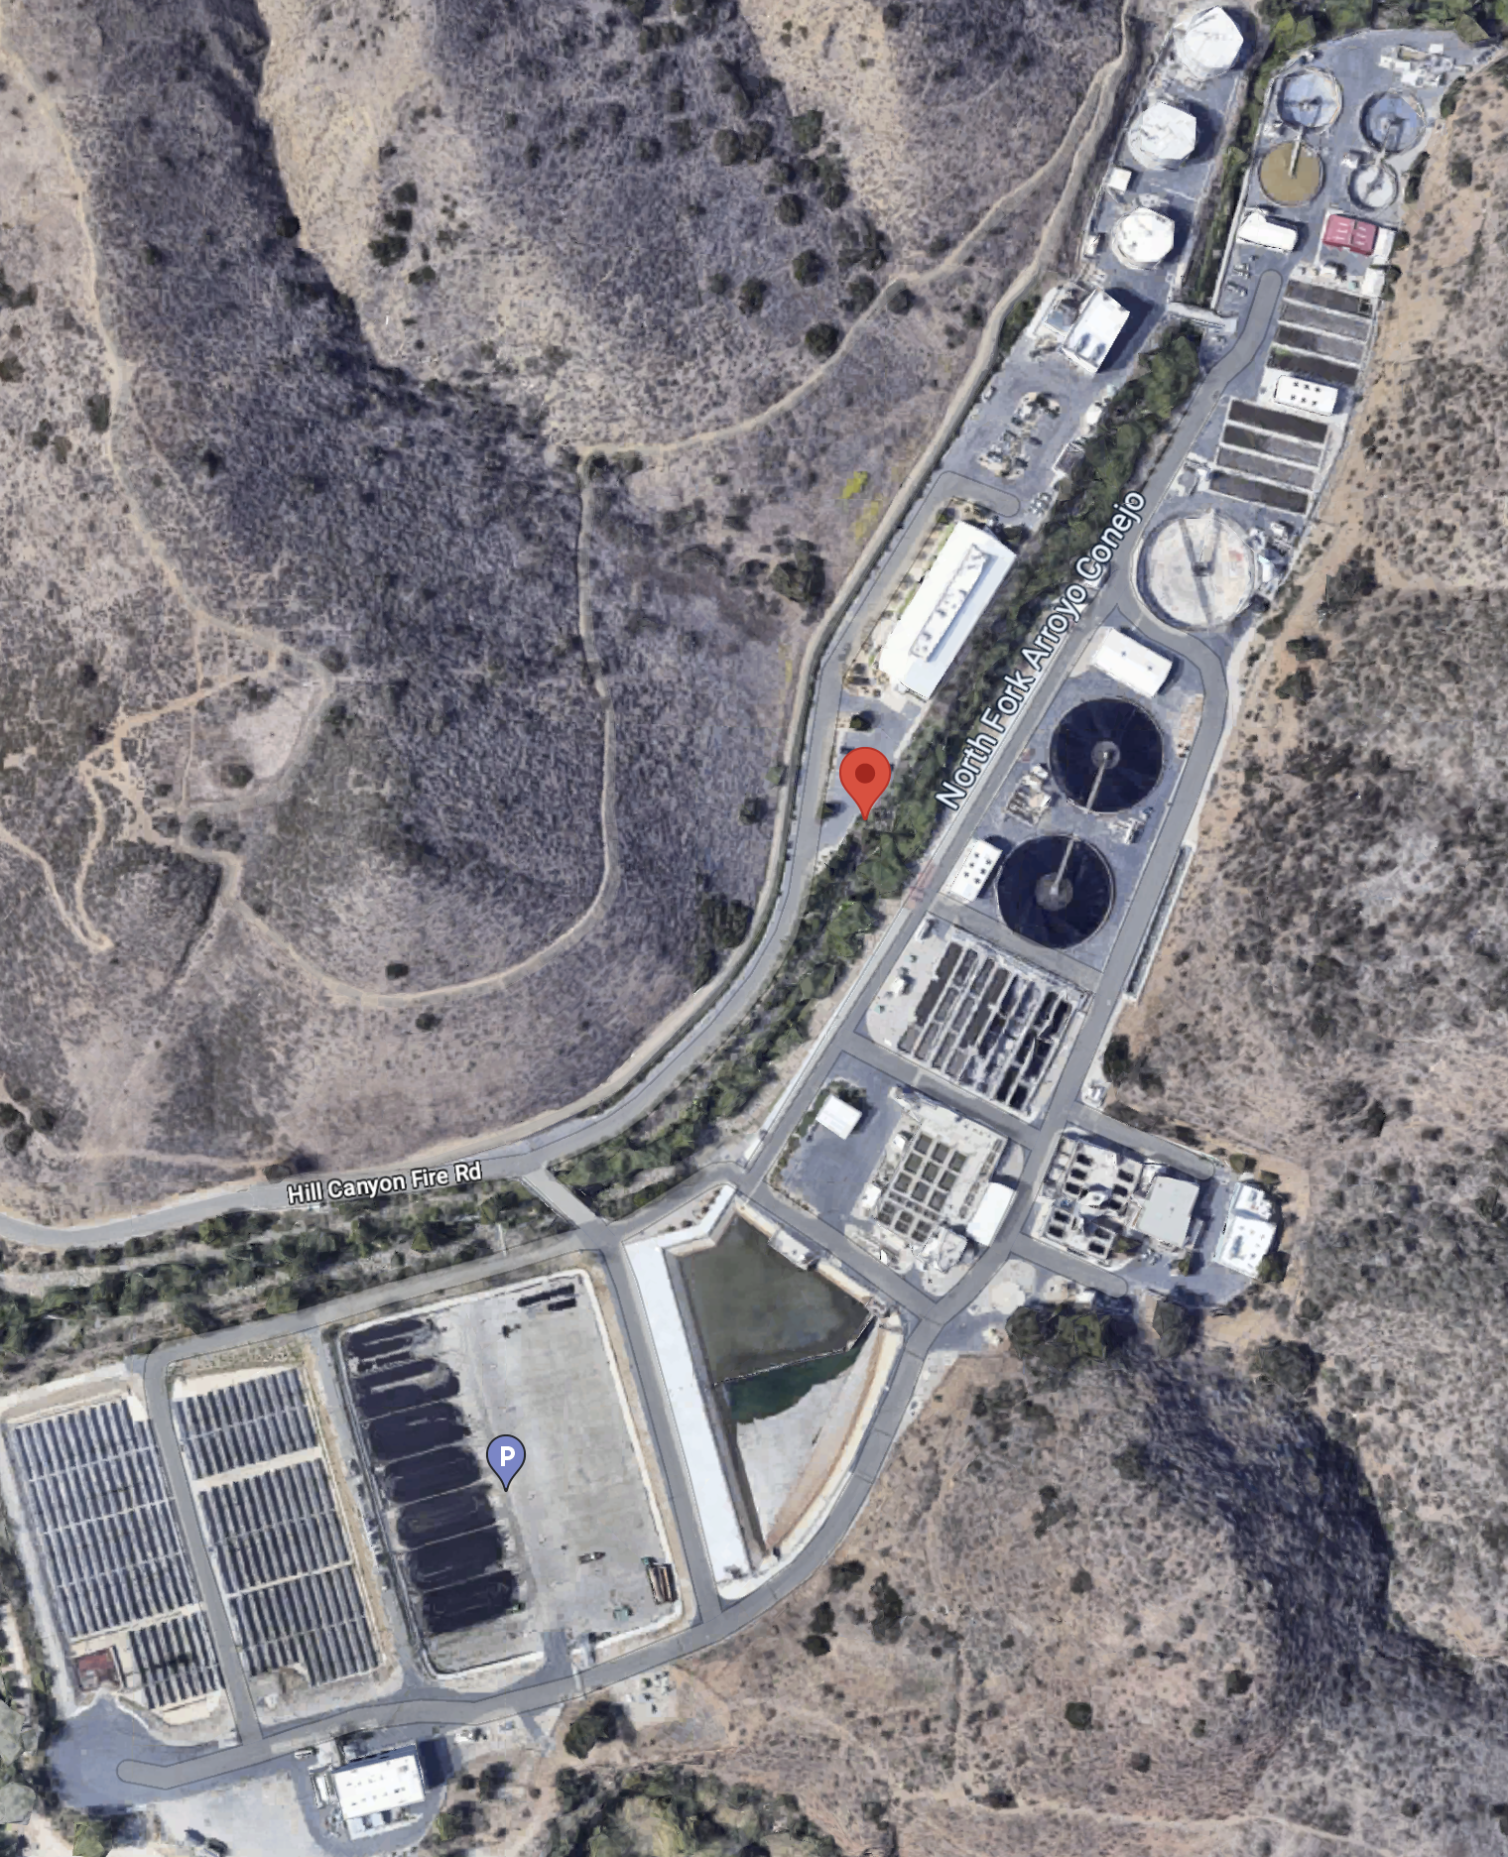
Solar Panel Analysis
-118.922251, 34.212534

Slide 15
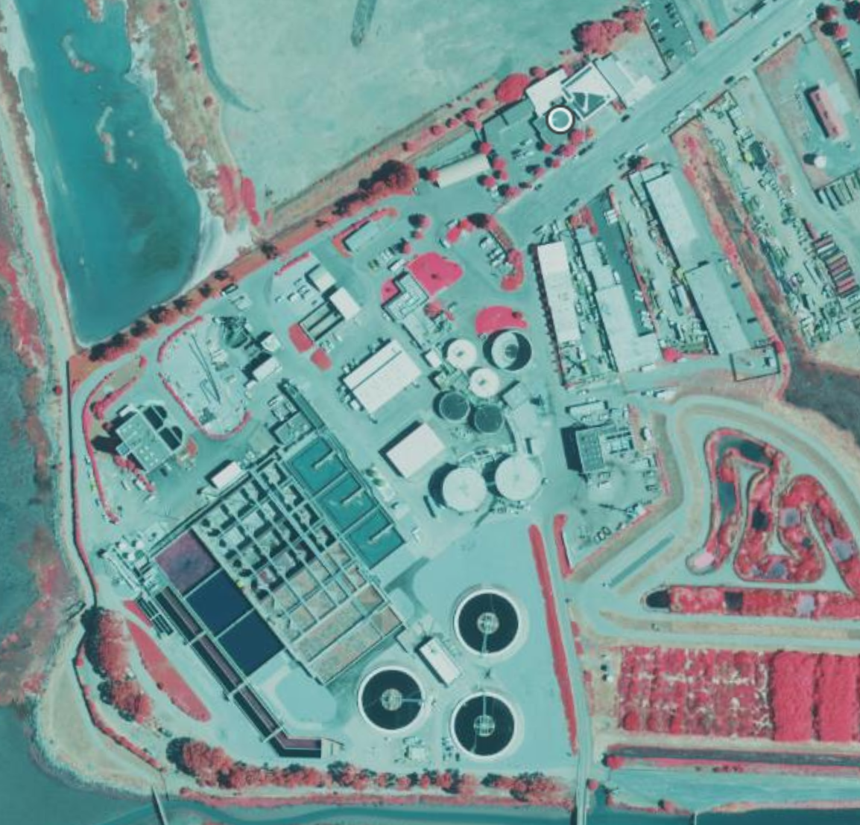
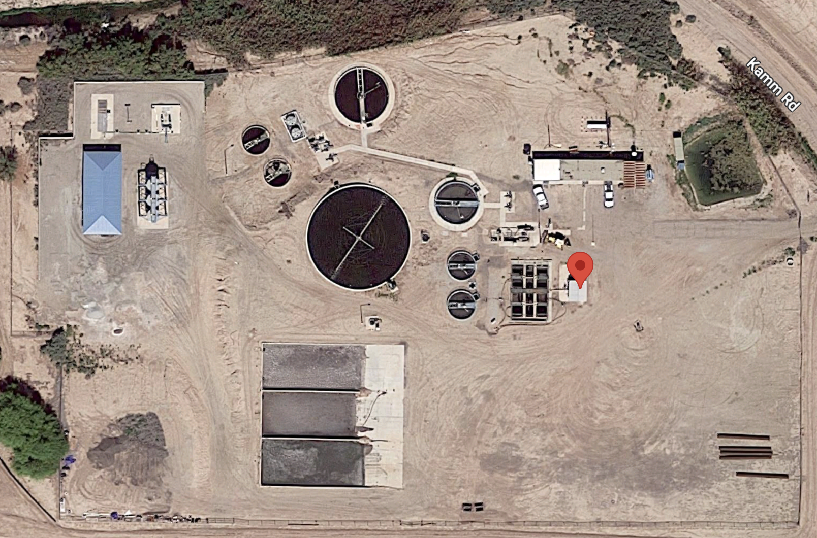
Solar Panel Key Concerns and Questions
No Solar Panels Onsite
-122.1584172, 37.6692524
-118.922251, 34.212534

Slide 16
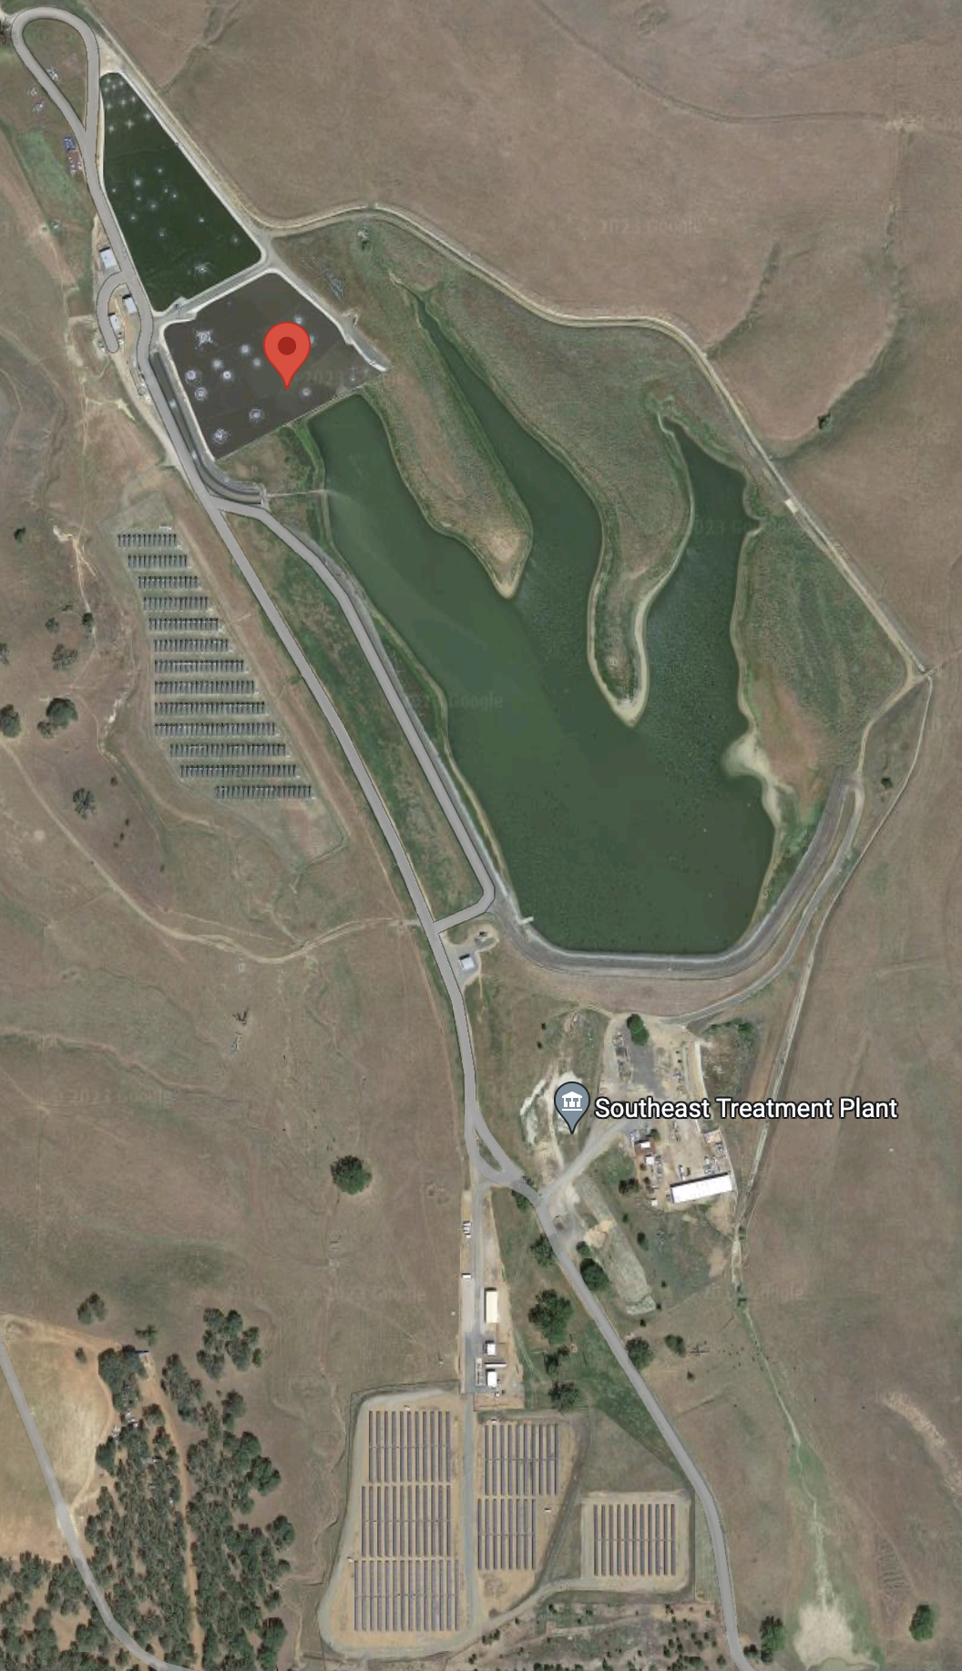
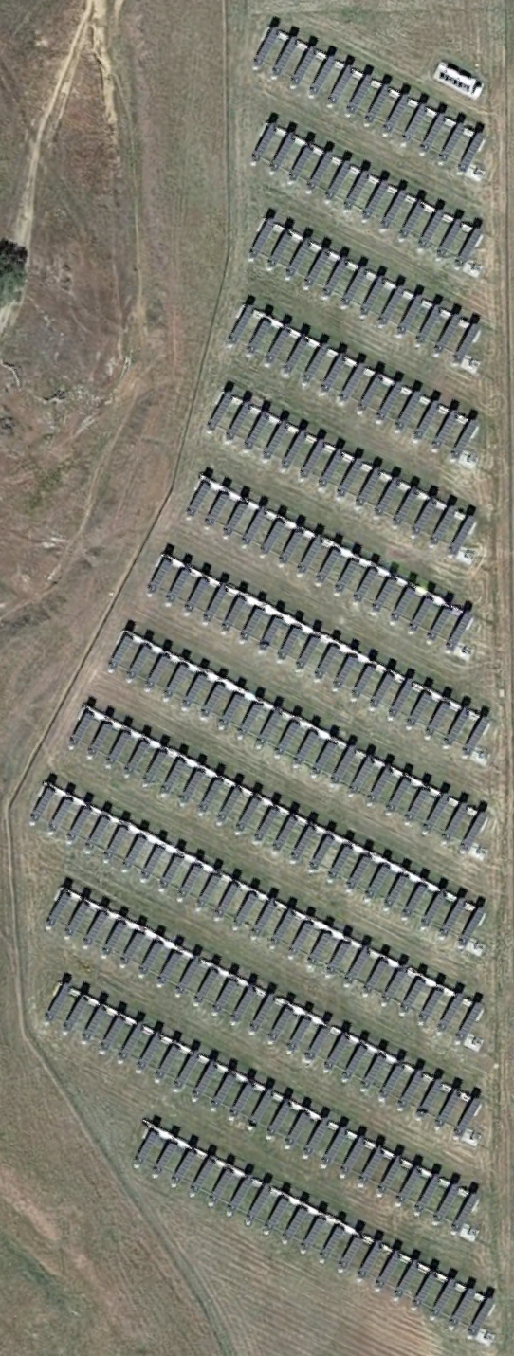
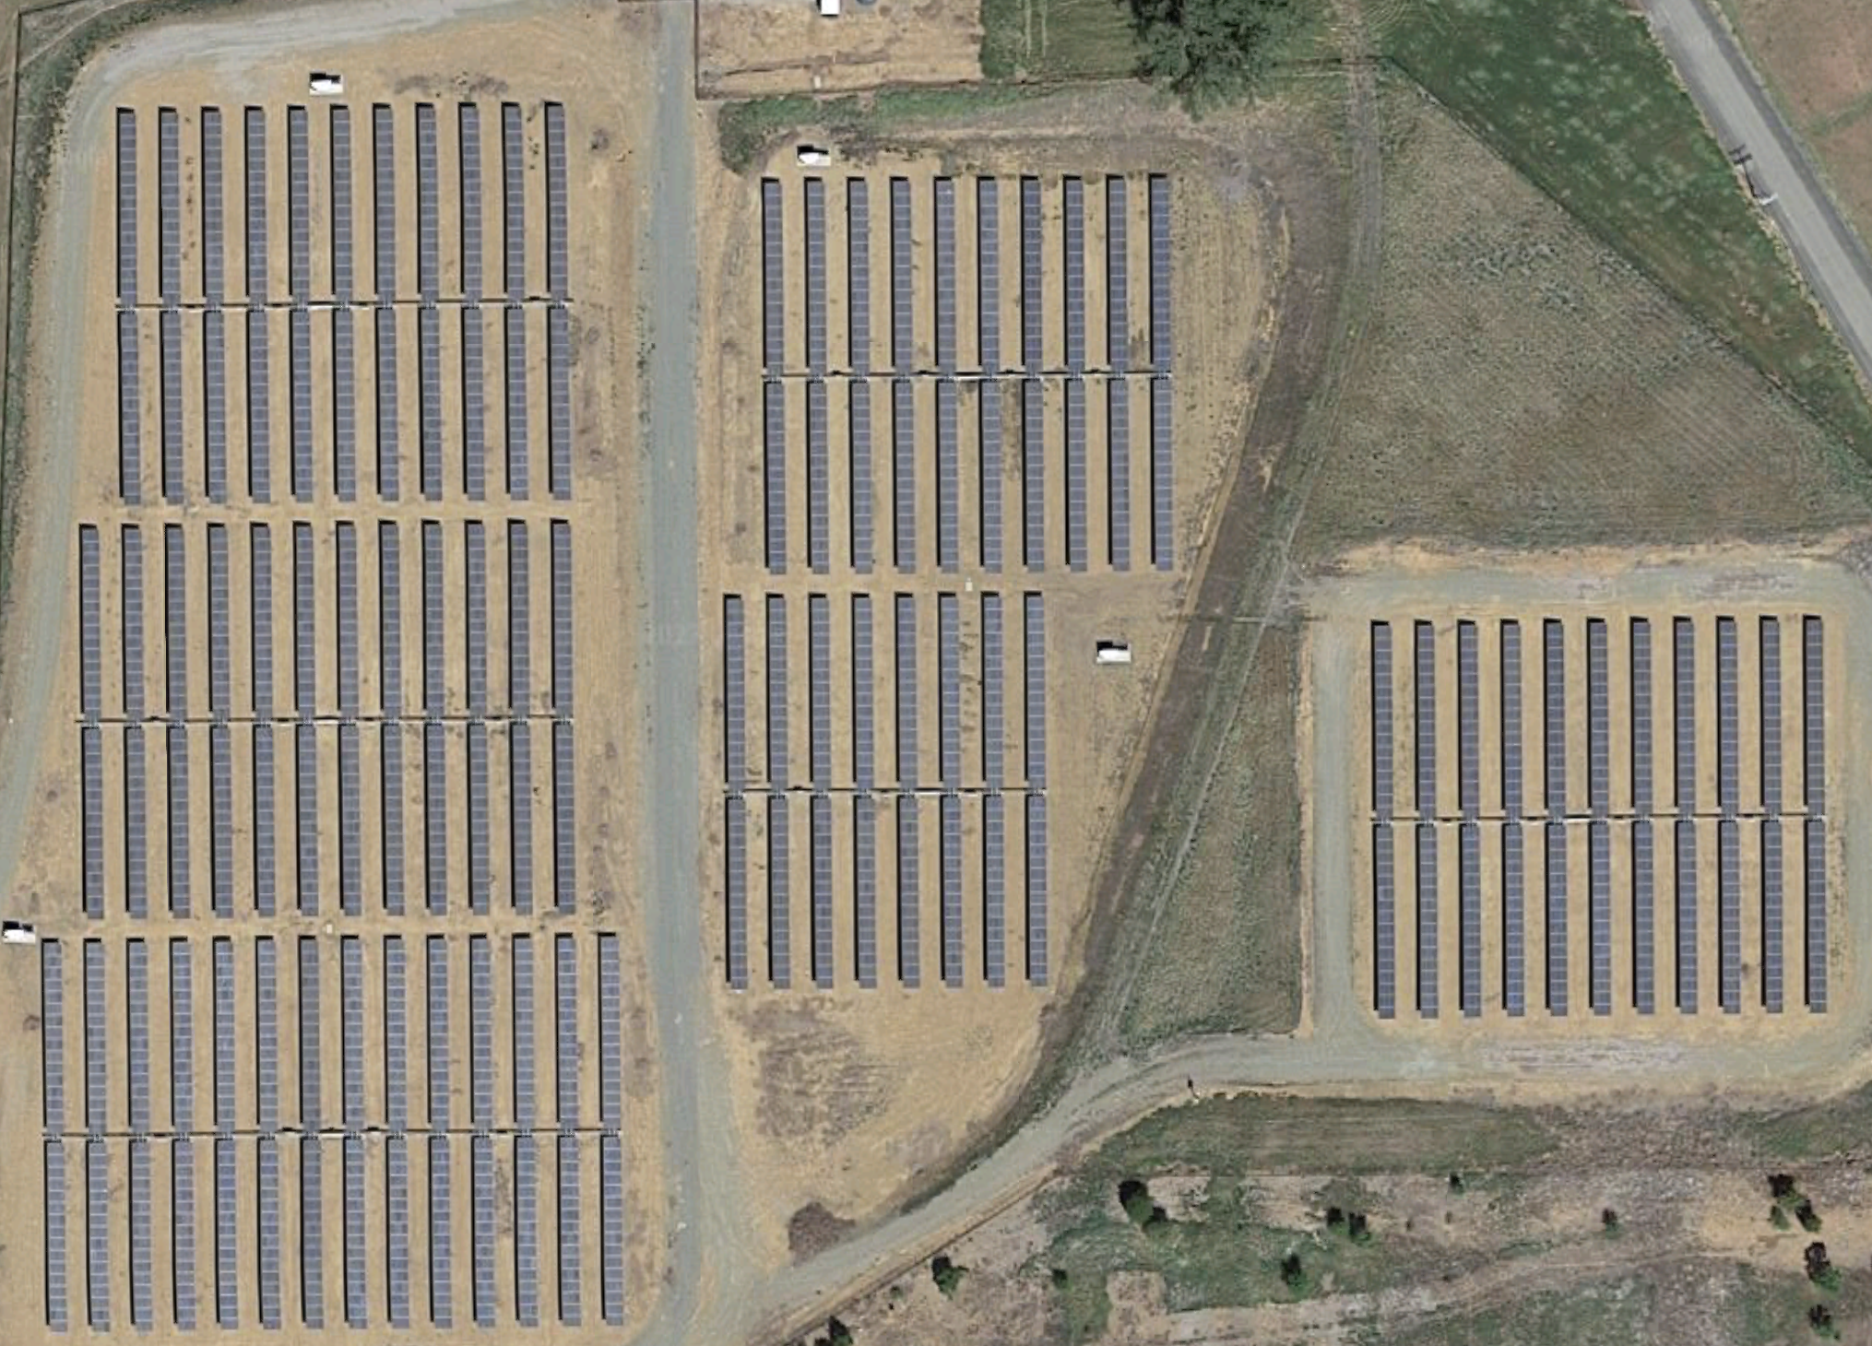
Solar Panel Key Concerns and Questions
Multiple Locations of Solar Panels
1
2
1
2
-122.626077, 38.985539

Slide 17
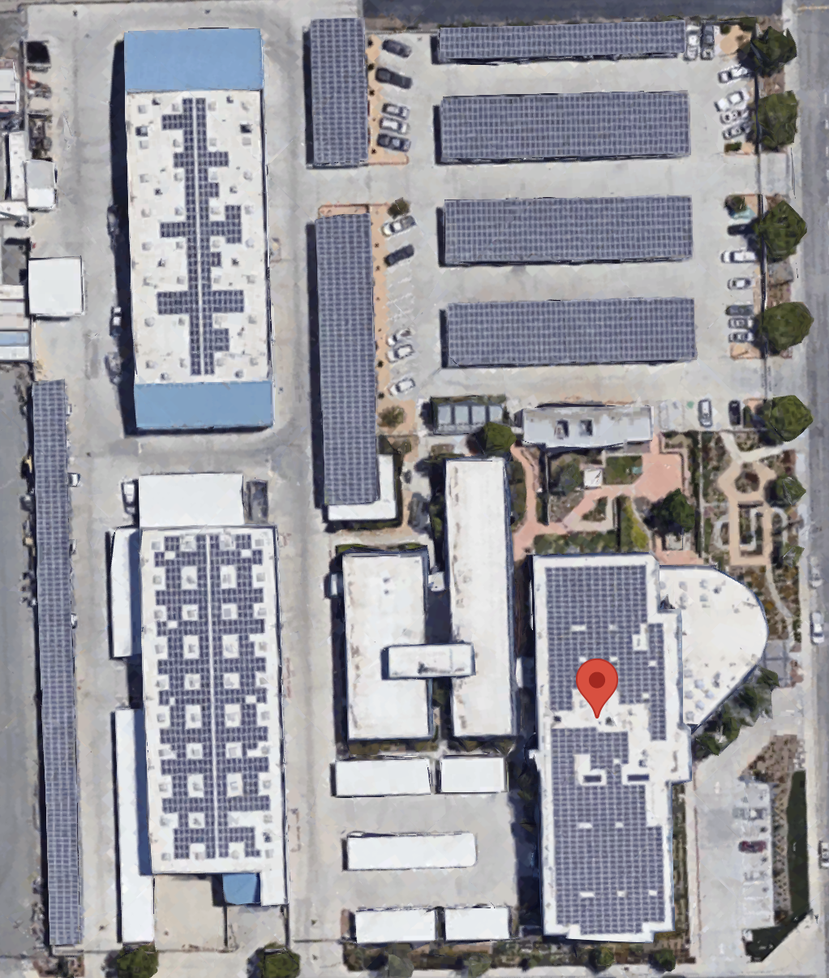
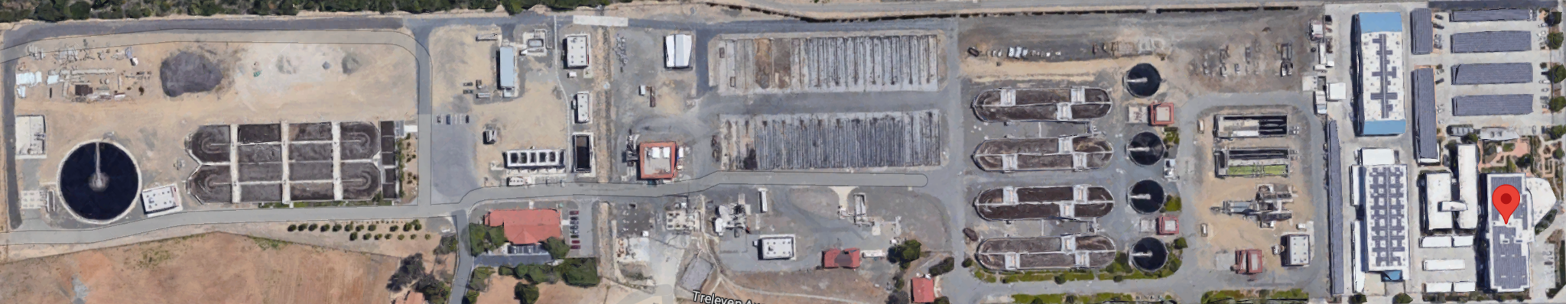
Solar Panel Key Concerns and Questions
Intention/Actual Use of Solar Panels
Assumption - Any solar panels onsite are designated for WWTP use
-117.3394213, 33.6803435

